Slide 1
Marvel vs DC:
THE ULTIMATE TEST

Slide 2


Who Is More Popular?

Slide 3
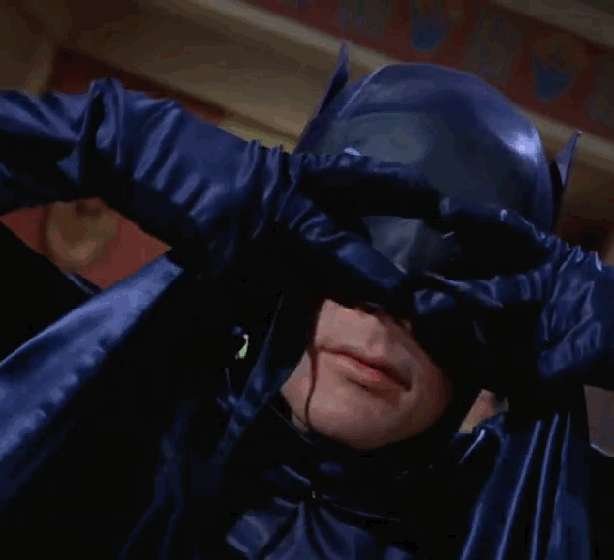
Movies

Slide 4
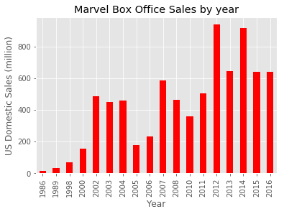
Total Movies Sales - Marvel vs DC

Slide 5
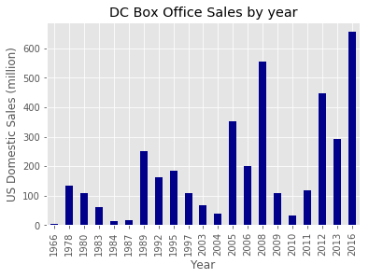
Total Movies Sales - Marvel vs DC

Slide 6
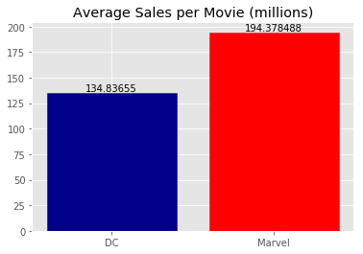


Total Movies Sales - Marvel vs DC

Slide 7
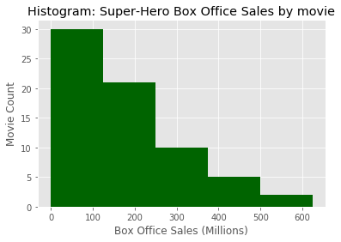
Marvel vs DC - Movie Sales

Slide 8
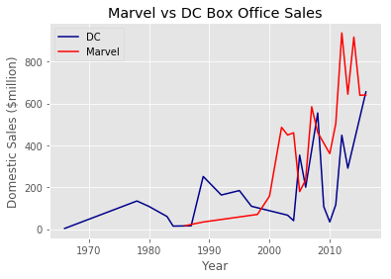
Total Movies Sales - Marvel vs DC

Slide 9
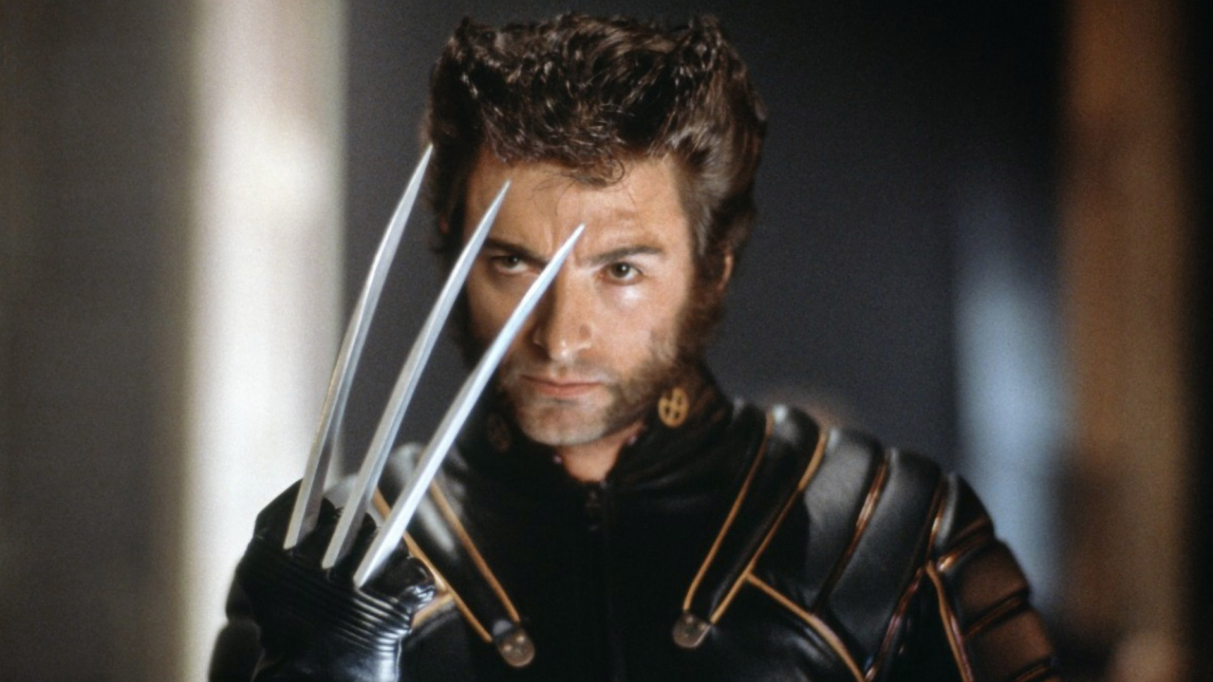
Total Movies Sales - Marvel vs DC

Slide 10

Total Movies Sales - Marvel vs DC

Slide 11
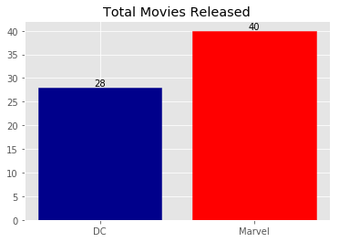
Marvel vs DC - Movies Released

Slide 12
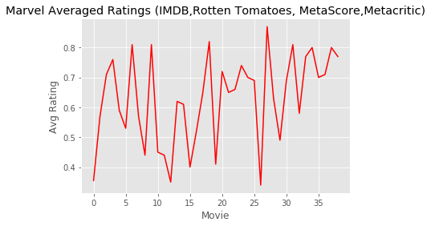
Average Marvel Movie Rating

Slide 13
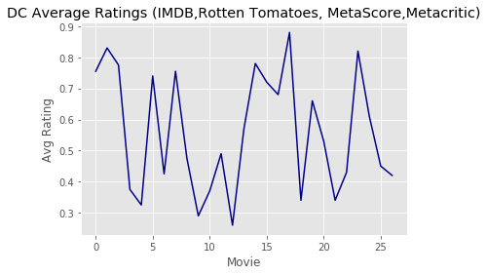
Average DC Movie Rating

Slide 14
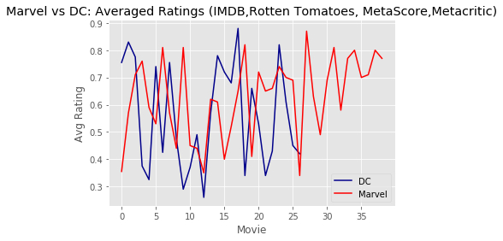
Combined Ratings

Slide 15
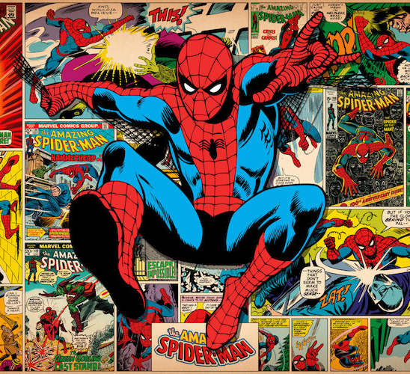
Comics

Slide 16
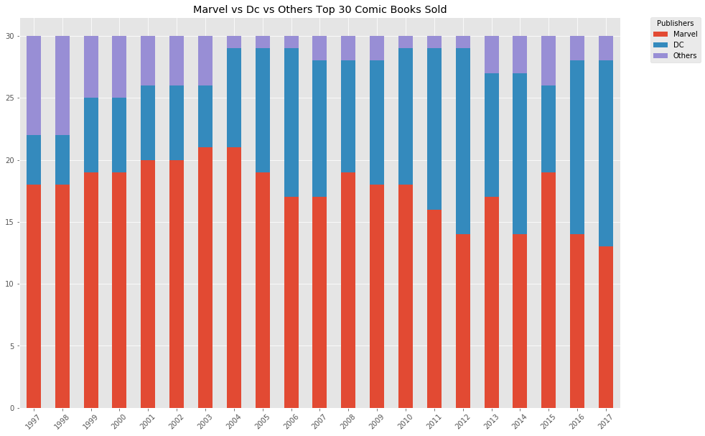
Marvel vs DC vs Others Top 30 Comics Sold

Slide 17
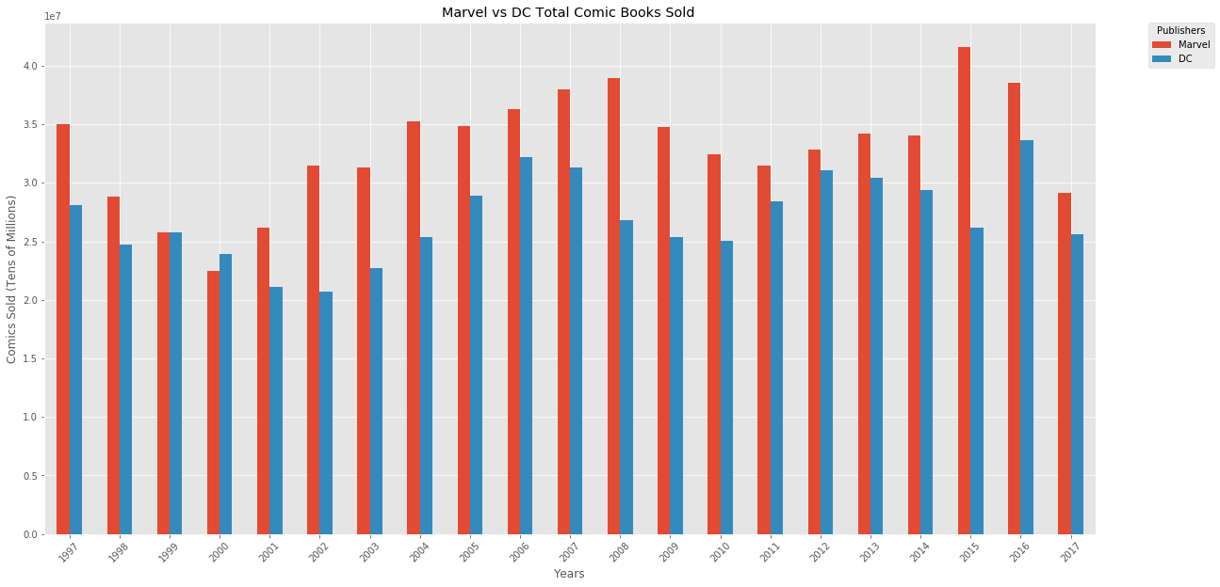
Marvel vs DC Total Comics Sold

Slide 18
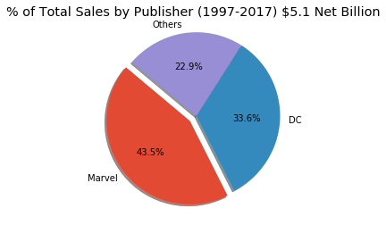
Marvel vs DC Total Comics Sold

Slide 19
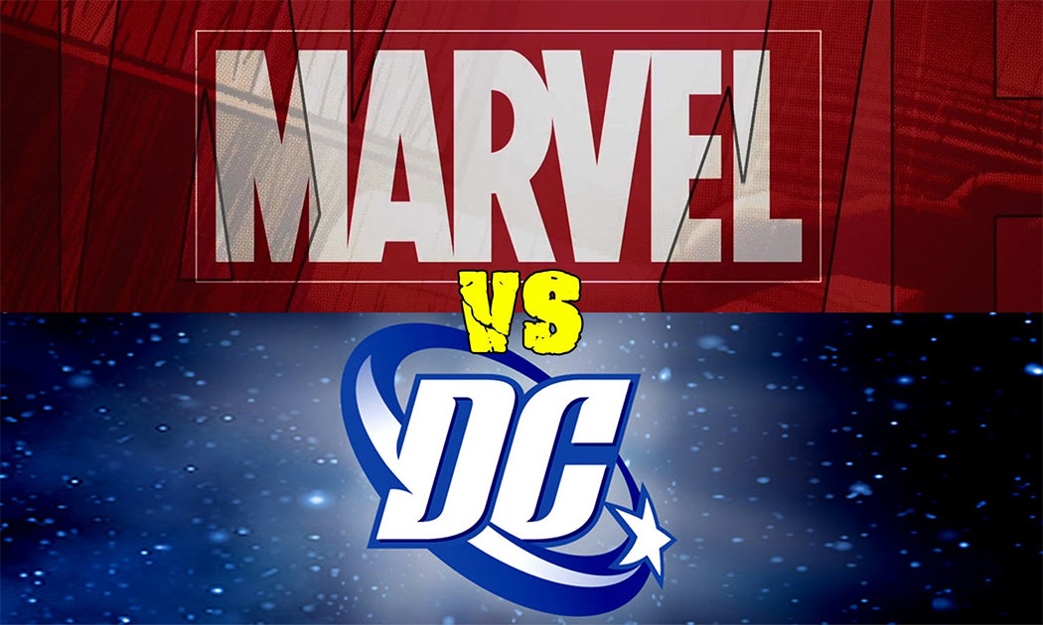
Verdict?

Slide 20
Verdict?
MARVEL WINS

Slide 21
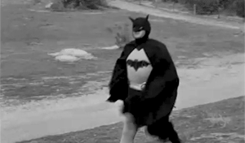
What else did we learn?

Slide 22
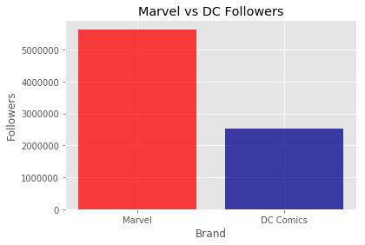
Marvel vs DC - Followers

Slide 23
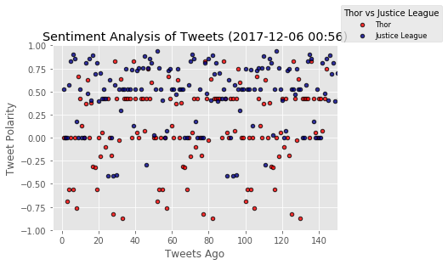
Twitter Sentiment - Thor vs Justice League

Slide 24
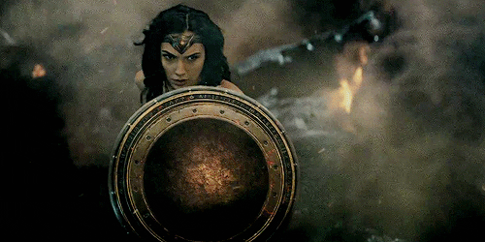
A Change of Tides?

Slide 25

Questions?

Slide 26




AENEAN IN MAGNA
AENEAN IN MAGNA
AENEAN IN MAGNA
Nullam nisl odio, mattis vel magna quis,
Nullam nisl odio, mattis vel magna quis,
Nullam nisl odio, mattis vel magna quis,
AENEAN IN MAGNA
AENEAN IN MAGNA
AENEAN IN MAGNA
Nullam nisl odio, mattis vel magna quis,
Nullam nisl odio, mattis vel magna quis,
Nullam nisl odio, mattis vel magna quis,

Slide 27






















Donec aliquet et ligula
Icons on this template have been downloaded from Flaticon

Slide 28
STEP 1
STEP 2
STEP 3
Pellentesque
Pellentesque
Pellentesque

